Slide 1
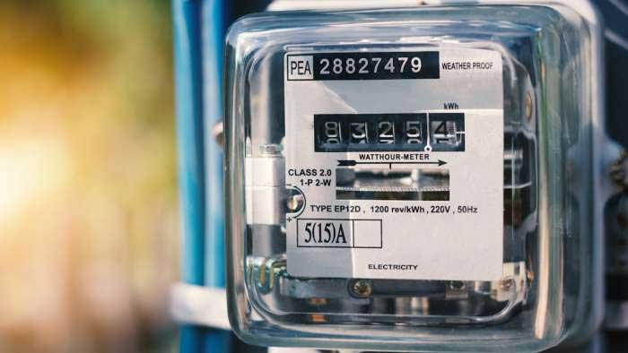


STEG - Tunisian Company of Electricity and Gas Fraud detection By: Tal Dekel

Slide 2
Background:
Societe Tunisienne del'Electricite at du Gaz (STEG) is the leading electricity and gas provider in Tunisia.
STEG has almost 5 million customers (4mill electricity and 1mill gas consumers) and provides over 15k GW/H annually.
STEG suffered tremendous losses in the order of 200 million Tunisian Dinars (~70 million USD) due to fraudulent manipulations of meters by consumers.
Objective:
While all of STEG’s clients are metered, electricity theft has been a growing challenge since the Revolution, reflecting a deterioration of the social contract. This project focuses on predicting the fraudulent customers.
Data source:
Kaggle - Fraud Detection in Electricity and Gas Consumption:
https://www.kaggle.com/mrmorj/fraud-detection-in-electricity-and-gas-consumption

Slide 3
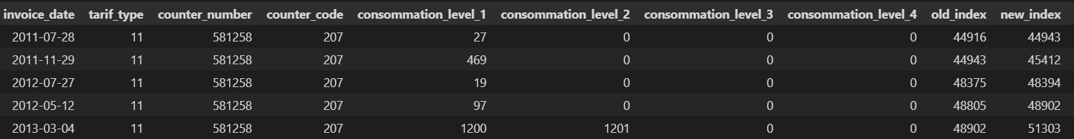
EDA process:
340MB csv file with 4.47m records and 22 columns, 137K clients
We’ve found a problem with the timeline continuity and decided to focus on the meter readings as a feature representing the timeline.
Gas and electricity have different tariff types.
Certain districts and regions showed higher proportion between fraudulent and regular clients.
Fraudulent clients were identified as more likely to change meters during their lifetime.
We’ve noticed a higher percent of average monthly consumption values for fraudulent clients in particular segments of the consumption scale.

Slide 4
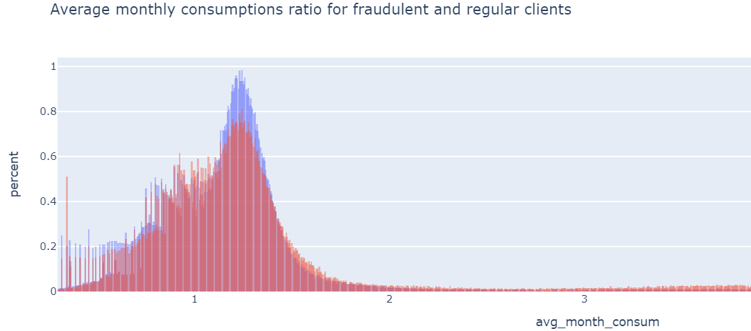
Feature engineering:
We had gone through the process of feature engineering 3 times, with the aim of improving models’ performance and ended up with 9 features.
Our guideline in performing this task was reaching a “wide form” format in the most efficient way, with 1 line remaining per client.
For features with higher fraudulent clients’ proportion, we calculated the ratio between them and all clients.
Irregular meter readings between ending and starting points, led us to chose it as an indication of fraud.
Fraudulent clients higher avg. month consumption

Slide 5
Models' performance:
The models used: LR, DT, RF, XGB, LGBM and Voting.
We tried PCA for dimensionality reduction, which was fruitless.
Our data was imbalanced (1 to 17 ratio) which had to be taken into account during data splitting and models’ class weight.
We performed Cross validation and Grid search for optimization.
AUC score was our main metric for model evaluation.
We used the Voting model but there was no improvement in the result.
For our business requirements we chose f-beta as the score for optimizing the Recall/Precision ratio. Few Betas were tested in order to find the optimal.

Slide 6
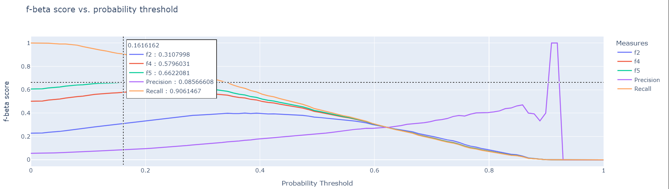
Results and conclusions:
Changing the class weight from ‘balanced’ to a lower ratio improved the model.
Feature engineering was the key for improving the models.
Model | AUC train | AUC test | f-Beta | Threshold | Recall | Precision
LGBM | 0.788 | 0.794 | 0.662 | 0.161 | 0.91 | 0.09

